Slide 1

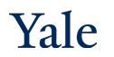
Deep Learning Theory and Applications
AMTH/CBB 663
CPSC 452/552

Slide 2
Whats your favorite show to binge-watch during the pandemic?

Slide 3
Outline
Course logistics
What is Deep Learning?
Deep learning examples
CNNs
GNNs
RNNs
Transformers
Autoencoders
Ultra deep learning (ResNet)
Generative models (e.g. GANs)
Deep Reinforcement Learning

Slide 4
Course Logistics
Textbooks (available online)
Neural Networks and Deep Learning by Michael Nielsen
Deep Learning by Goodfellow, Bengio, and Courville
Graph Representation Learning by William Hamilton
Required background
Basic probability
Linear algebra & calculus
Programming experience
Python and PyTorch will be used in this course
Canvas
Lectures recorded and posted after class
Announcements & HW
Piazza
Please sign in via link
piazza.com/yale/spring2022/cpsc45201cpsc55201amth55201cbb66301/home

Slide 5




Instructor TA and ULA
Instructor: Smita Krishnaswamy
TA: Sumner Magruder
ULAs: Kincaid Macdonald, Ross Johnson, Chae Young Lee
Sumner
Kincaid
Ross
Chae Young

Slide 6
Office hours
Office hours by ZOOM: 991 8356 1572
Instructor Office Hours: After class Tuesdays 1-2
OR by appointment (email me).
Sumner: Monday 10-12pm
Kincaid: Friday 3-5pm
Ross: Tuesdays 7:3—9:30pm
Chae Young: Wednesdays 7-9pm
These may be subject to change

Slide 7
Homeworks and projects
4 HW assignments
All/most will include some programming (Python & Pytorch)
Approximately 3-4 weeks to do them
Final project (details forthcoming)
In groups of 3-4
Intro to Pytorch:
https://pytorch.org/tutorials/beginner/deep_learning_60min_blitz.html

Slide 8
Goals of the Course
Intuition behind “depth” in deep learning
Abstract features
Representation learning
An understanding of prominent deep architectures
The ability to design and train novel architectures for problems of interest
An understanding of how deep networks are trained and optimized
Awareness of emergent understanding of why neural networks actually generalize, and in what circumstances they “memorize”
Familiarity with problems in neural networks and future directions
Notes:
So this will be a very hands-on course

Slide 9
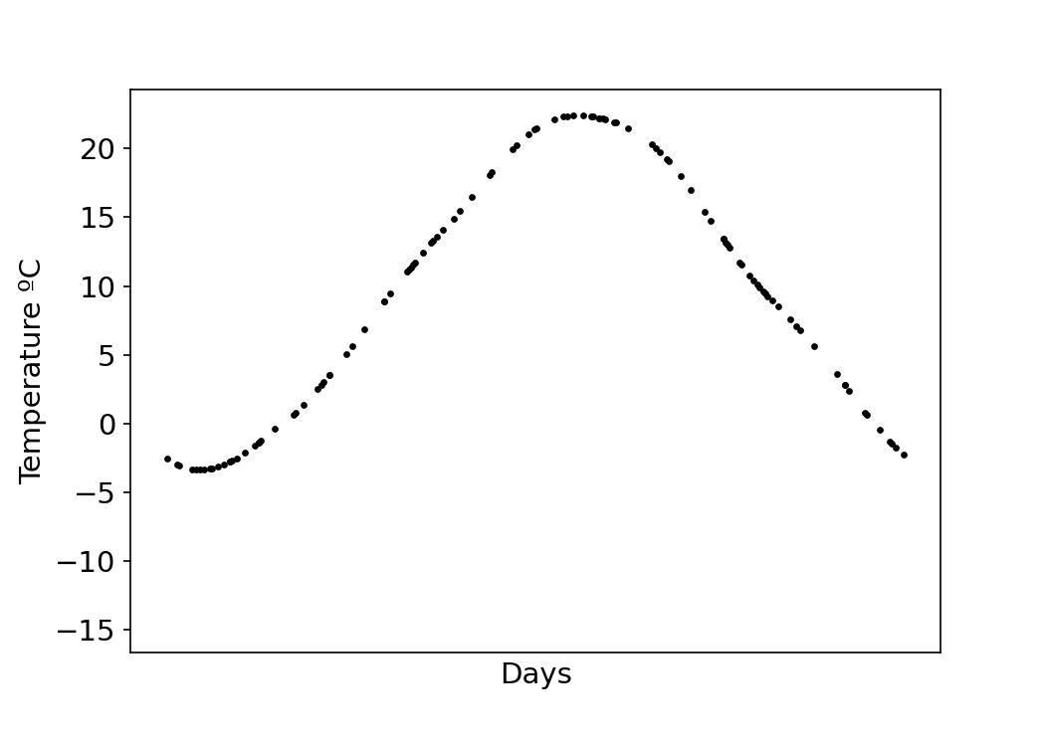
How can we train a model to predict something on unseen data?

Slide 10
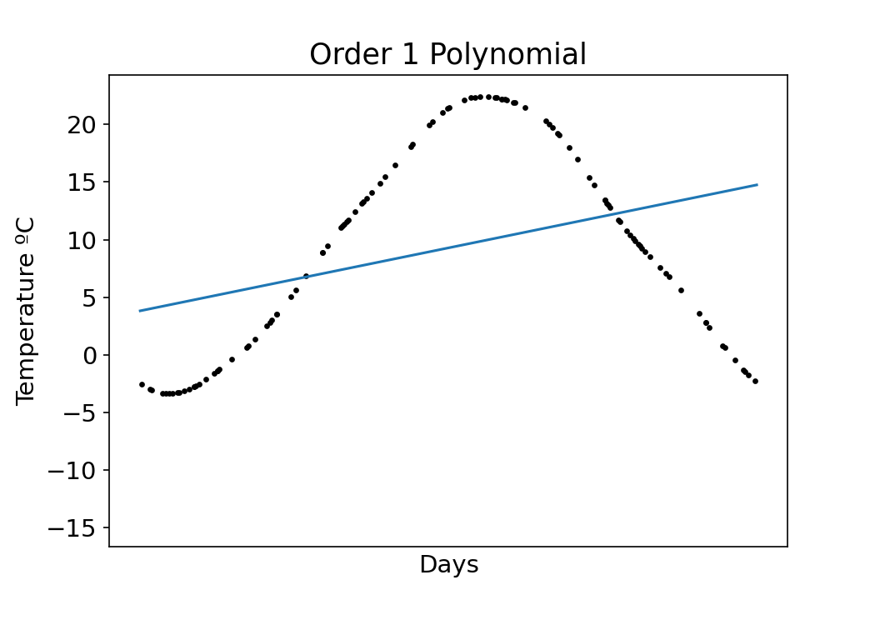
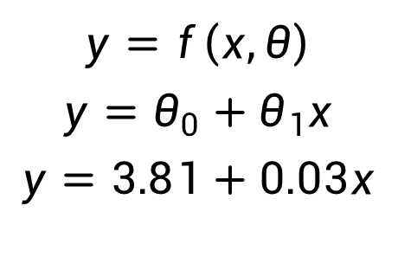
How can we train a model to predict a value on unseen data?
$$y=f\left(x,θ\right)$$
$$y=θ_{0}+θ_{1}x$$
$$y=3.81+0.03x$$

Slide 11
Predictions
$$y=f\left(x,θ\right)$$
$$y=θ_{0}+θ_{1}x$$
$$y=3.81+0.03x$$
Bias
Weight

Slide 12

Optimizing Parameters
$$y=f\left(x,θ\right)$$
$$y=θ_{0}+θ_{1}x$$
$$y=3.81+0.03x$$
$$y=θ_{0}+\sum_{i}{θ_{i}x^{i}}$$

Slide 13
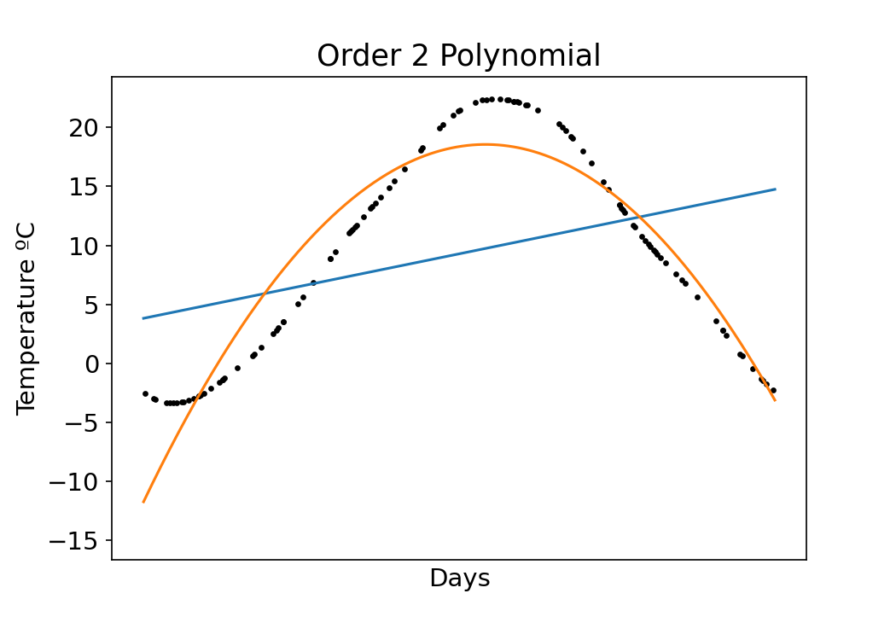
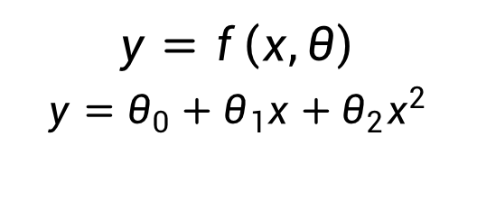
More parameters
$$y=f\left(x,θ\right)$$
$$y=θ_{0}+θ_{1}x+θ_{2}x^{2}$$

Slide 14
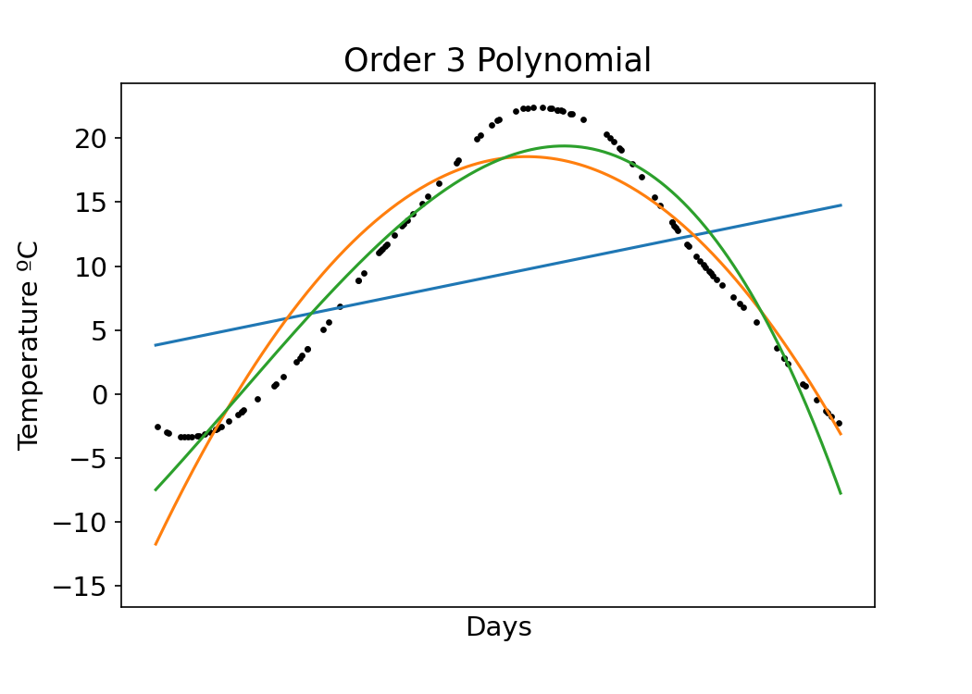
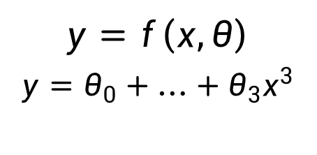
… even more parameters
$$y=f\left(x,θ\right)$$
$$y=θ_{0}+…+θ_{3}x^{3}$$

Slide 15
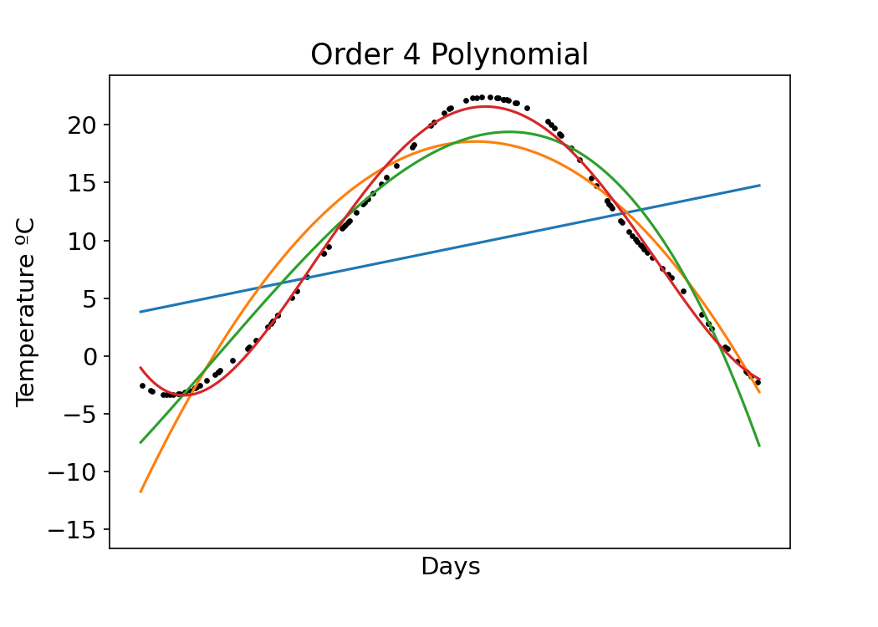
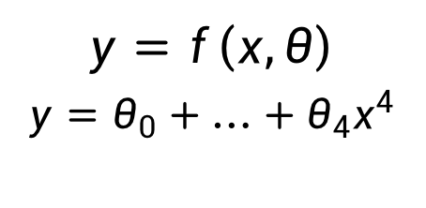
…even more parameters
$$y=f\left(x,θ\right)$$
$$y=θ_{0}+…+θ_{4}x^{4}$$

Slide 16
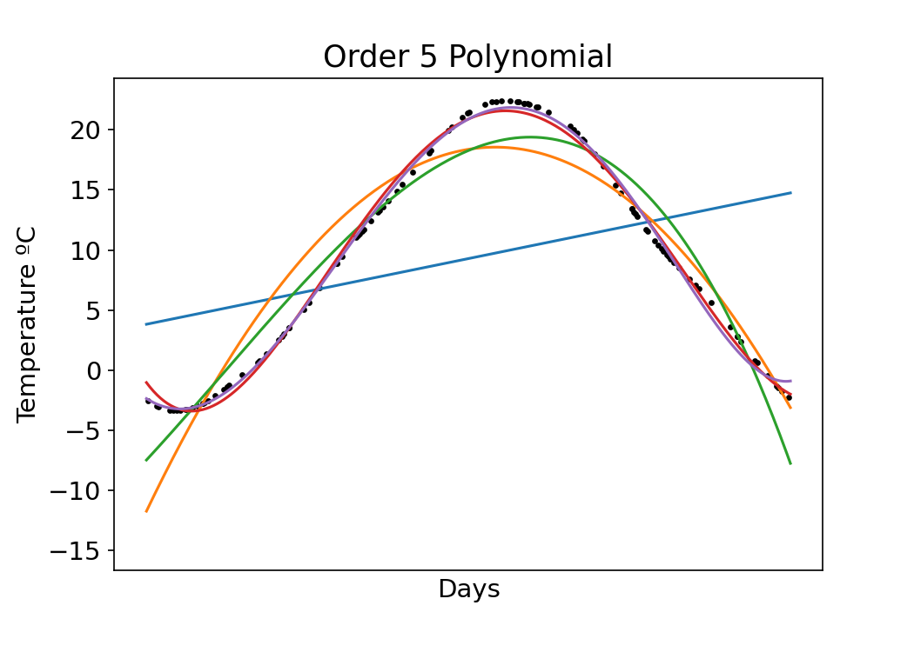
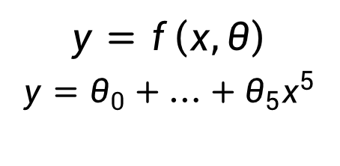
…even more parameters
$$y=f\left(x,θ\right)$$
$$y=θ_{0}+…+θ_{5}x^{5}$$
Increasing parameters improves model fit!

Slide 17
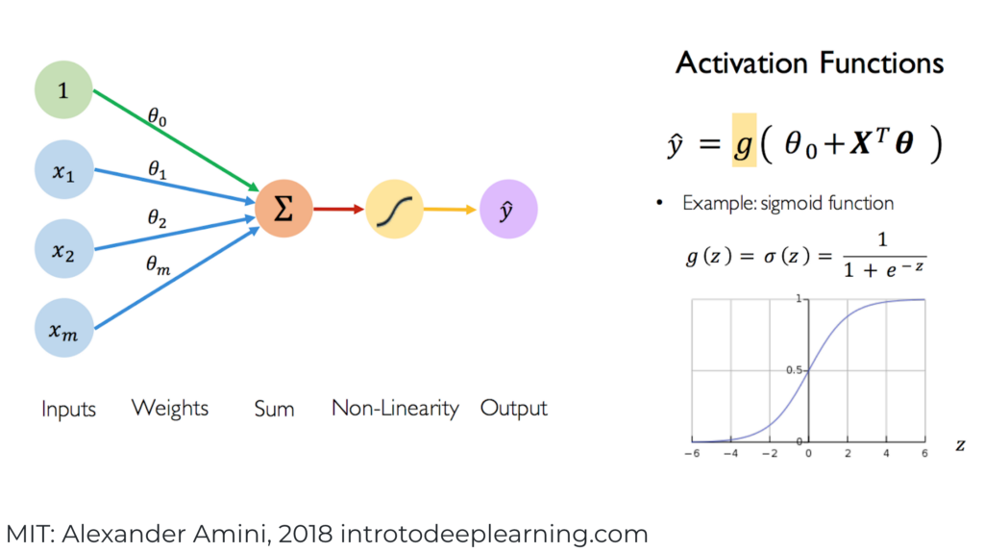
The heart of neural networks are weights and biases

Slide 18
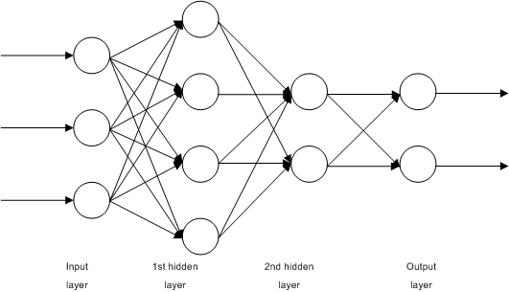
Nodes of a network are arranged in layers to form deep networks
WikiMedia

Slide 19
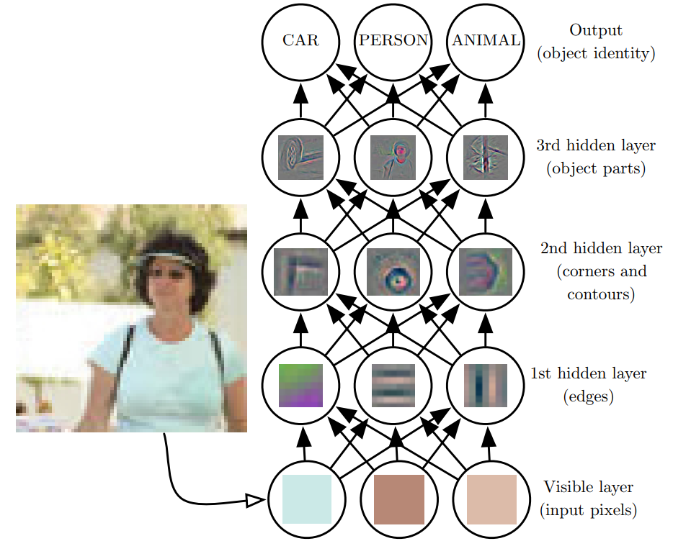
Network depth creates a composition of functions
Deep learning has the tendency to break the data down into different representations at different layers.
Input is presented at the visible layer
and the hidden layers extract increasingly abstract features which are then used, for example, to classify
images in circle are visualized feature maps in different layers
Goodfellow et al., 2016
Notes:
Deep learning has the tendency to break the data down into different representations at different layers. Input is presented at the visible layer and the hidden layers extract increasingly abstract features which are then used, for example, to classify

Slide 20
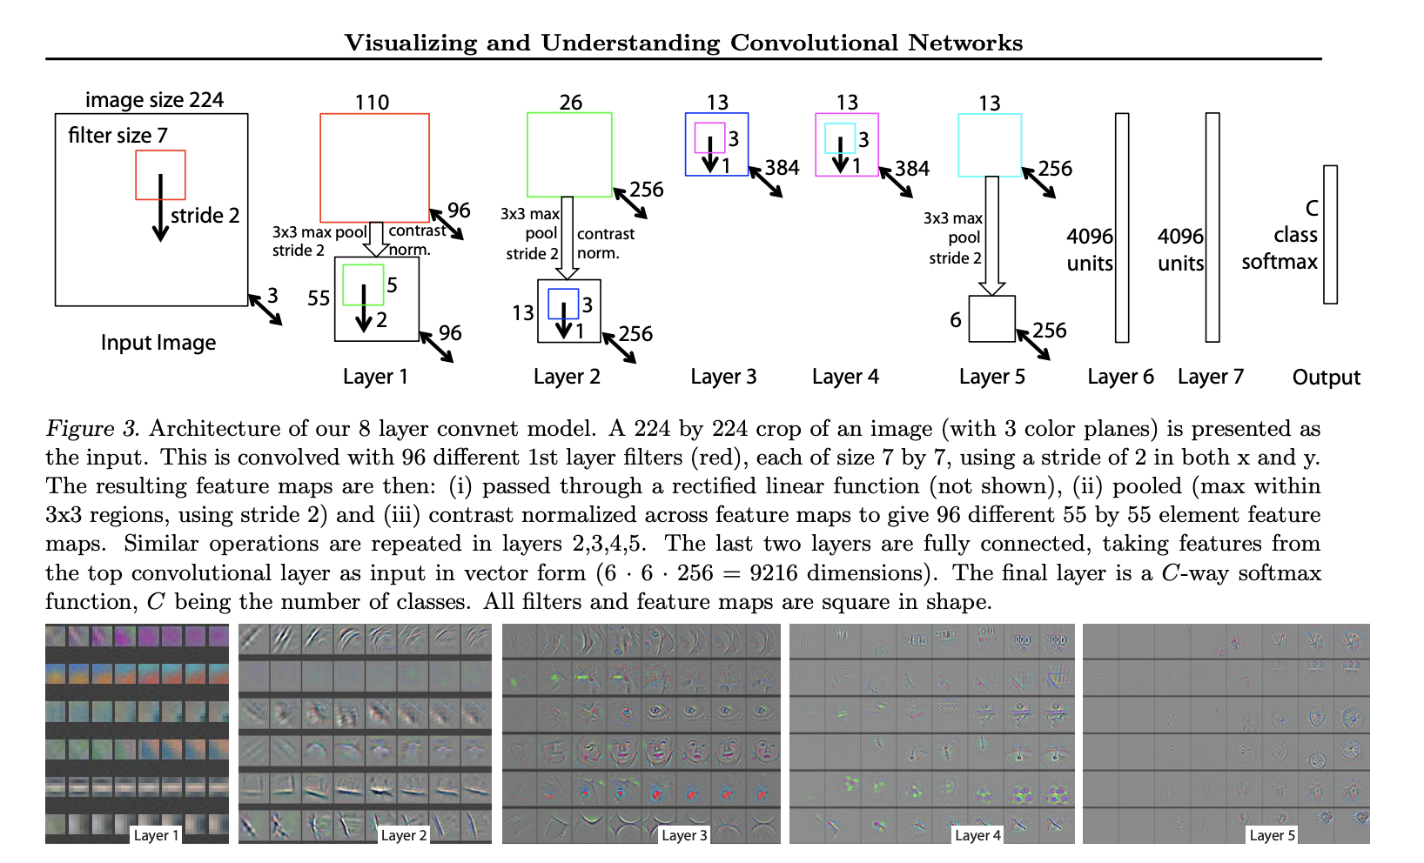
original paper visualizing and understanding convolutional network
https://arxiv.org/abs/1311.2901

Slide 21
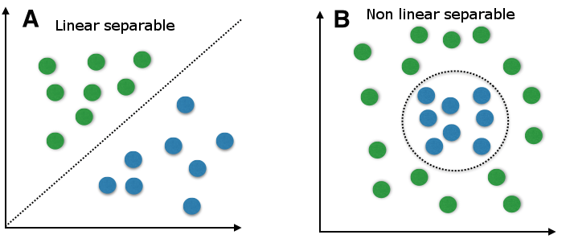
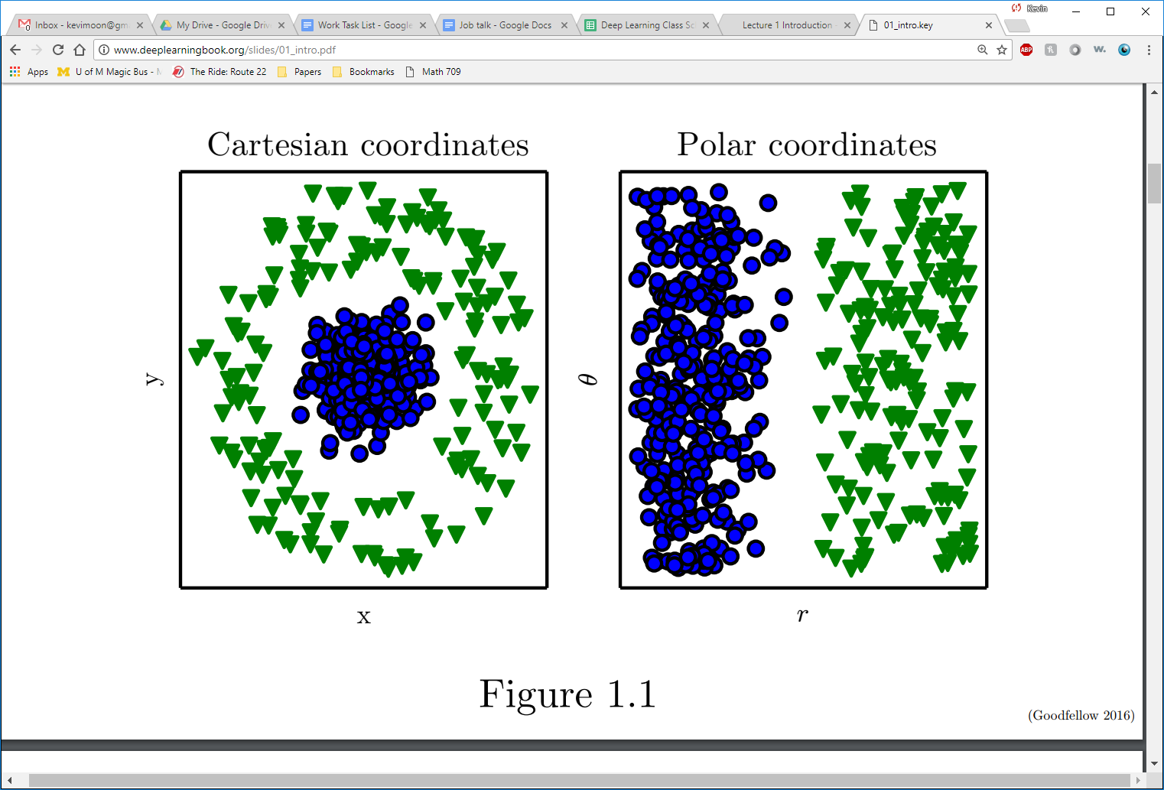
why deep?
higher complexity of learned function
shallow
deep
better representation learning
shallow
deep

Slide 22
Why go deep?
Depth = complexity
Single layer perceptrons can only handle linear separability

Slide 23
Representations matter
A major reason is that how the data is represented is important. On the left, if you were tasked with using a straight line to separate the two types of data, you would fail. On the right though, by simply transforming the data into a different coordinate system, it becomes very easy to do.
Goodfellow et al., 2016
Notes:
A major reason is that how the data is represented is important. On the left, if you were tasked with using a straight line to separate the two types of data, you would fail. On the right though, by simply transforming the data into a different coordinate system, it becomes very easy to do.

Slide 24
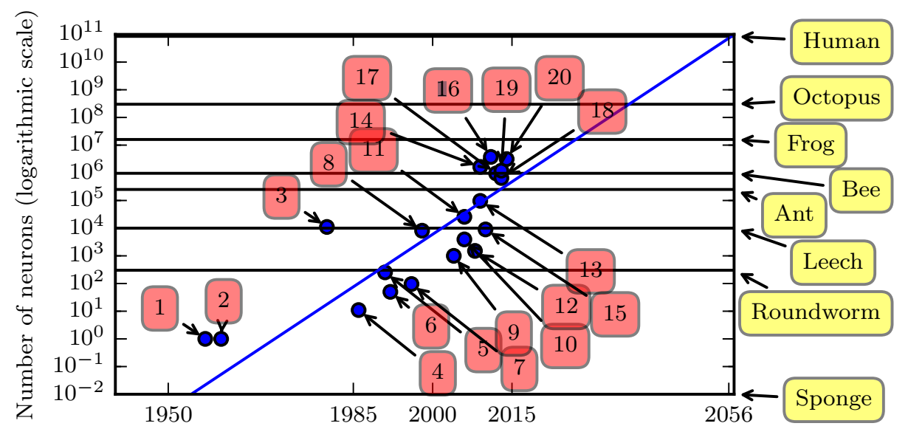
Increasing # of neurons
Neural network size is increasing over time. Note that we’re still below the level of a frog.
Goodfellow et al., 2016
1. Perceptron (Rosenblatt, 1958)
4. Early backpropagation network
6. MLP for speech recognition (Bengio et al, 1991)
11. GPU-accelerated convolutional network (Challeapilla et al., 2006)
20. GoogLeNet (Szegedy et al., 2014a)
Notes:
Neural network size is increasing over time. Note that we’re still below the level of a frog.

Slide 25
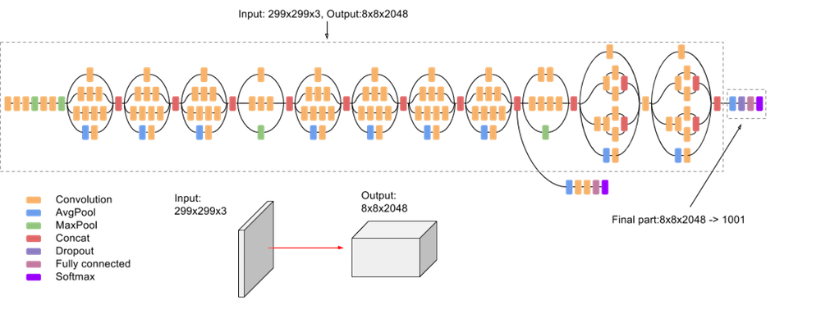
Layers can be arranged in arbitrary configurations to increase model power
Google’s Inception v3 Image Recognition network has 24M parameters!
Google

Slide 26
Layers can be arranged in arbitrary configurations to increase model power
What about overfitting?
Google’s Inception v3 Image Recognition network has 24M parameters!
Google

Slide 27
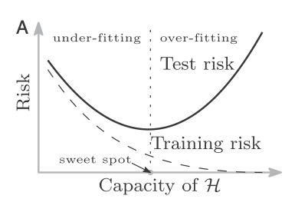
Classic risk curve
Belkin et al. PNAS (2019)

Slide 28
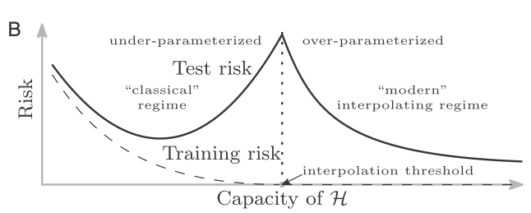
Double Descent
Belkin et al. PNAS (2019)

Slide 29
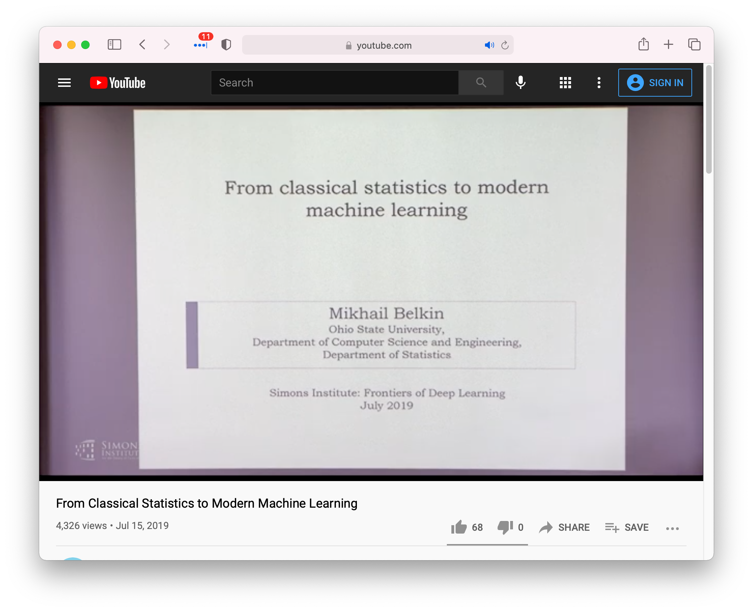
Double Descent
https://www.youtube.com/watch?v=OBCciGnOJVs&feature=youtu.be

Slide 30
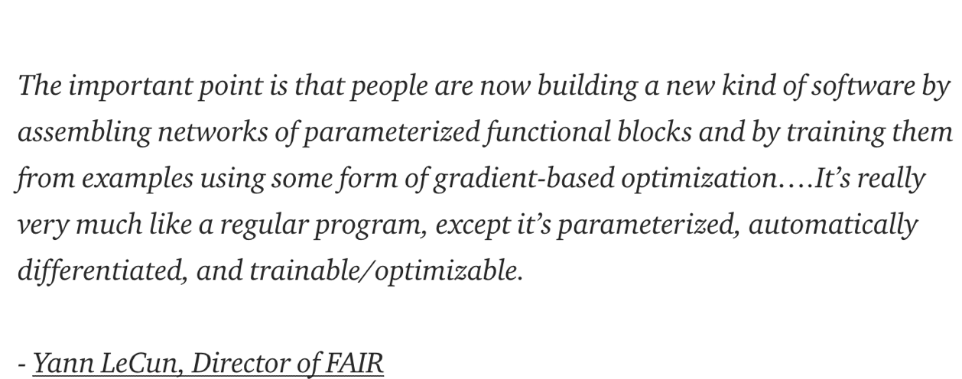
Differentiable Computing

Slide 31
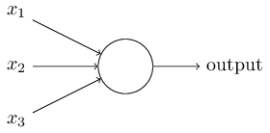

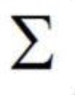
The perceptron
Developed in 1950’s and 1960’s by Frank Rosenblatt
Binary inputs
Single binary output
Example:
0 or 1
w1
step
w2
0 or 1
0 or 1
0 or 1
w3
Nielsen, 2015
In general could have more or fewer inputs.
Mention that figures come from Michael Nielsen’s book
Notes:
In general could have more or fewer inputs.
Mention that figures come from Michael Nielsen’s book

Slide 32
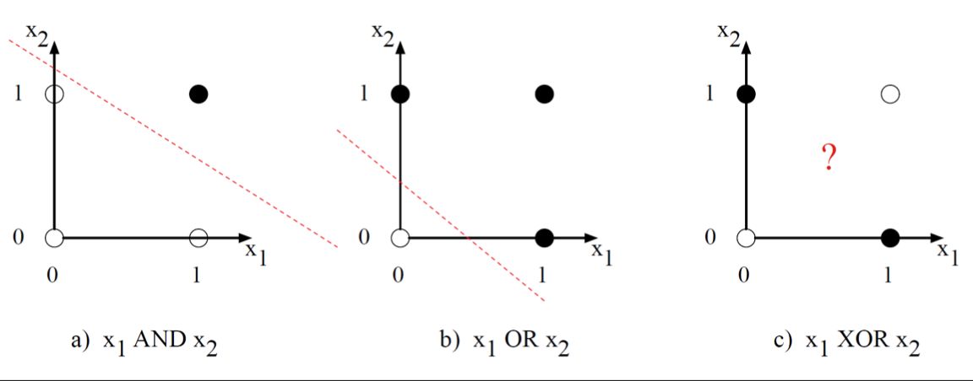
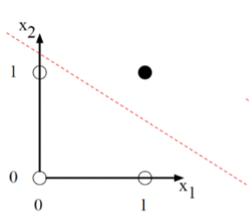
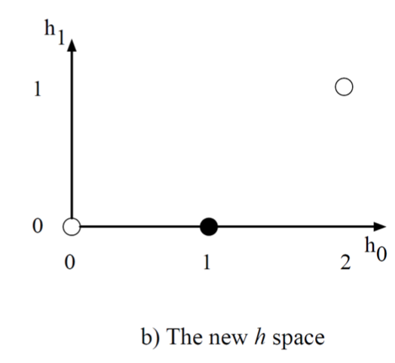


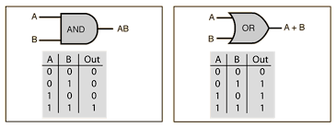
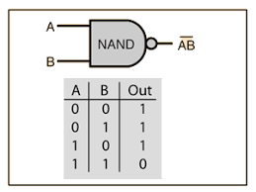
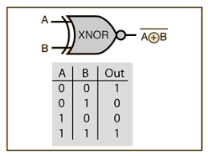
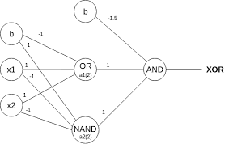
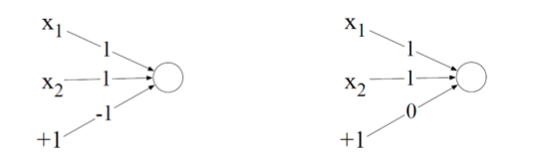
perceptron can solve AND, OR, NAND, can’t solve XOR
linearly separable in input space
linearly unseparable
in input space
linearly separable
in hidden space
x₁ NAND x₂
input (0,1) overlap with
input (1, 0) in hidden space
A single perceptron is a linear binary classifier
2-layer MLP with 3 perceptrons
-1
-1
1.5

Slide 33
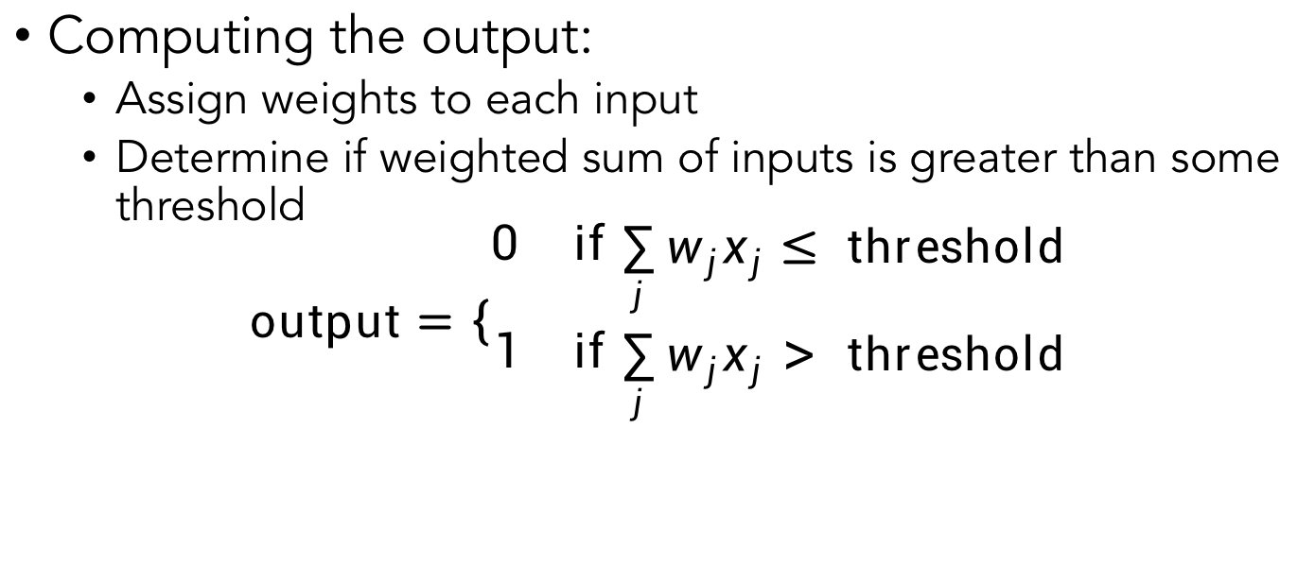
The perceptron
Nielsen, 2015
Computing the output:
Assign weights to each input
Determine if weighted sum of inputs is greater than some threshold
$$\text{output}=\left\{\begin{aligned}\begin{matrix}0 & \text{if} \end{matrix}\sum_{j}{w_{j}x_{j}}≤ \text{threshold} \\ \begin{matrix}1 & \text{if} \end{matrix}\sum_{j}{w_{j}x_{j}> \text{threshold}}\end{aligned}\right.$$

Slide 34
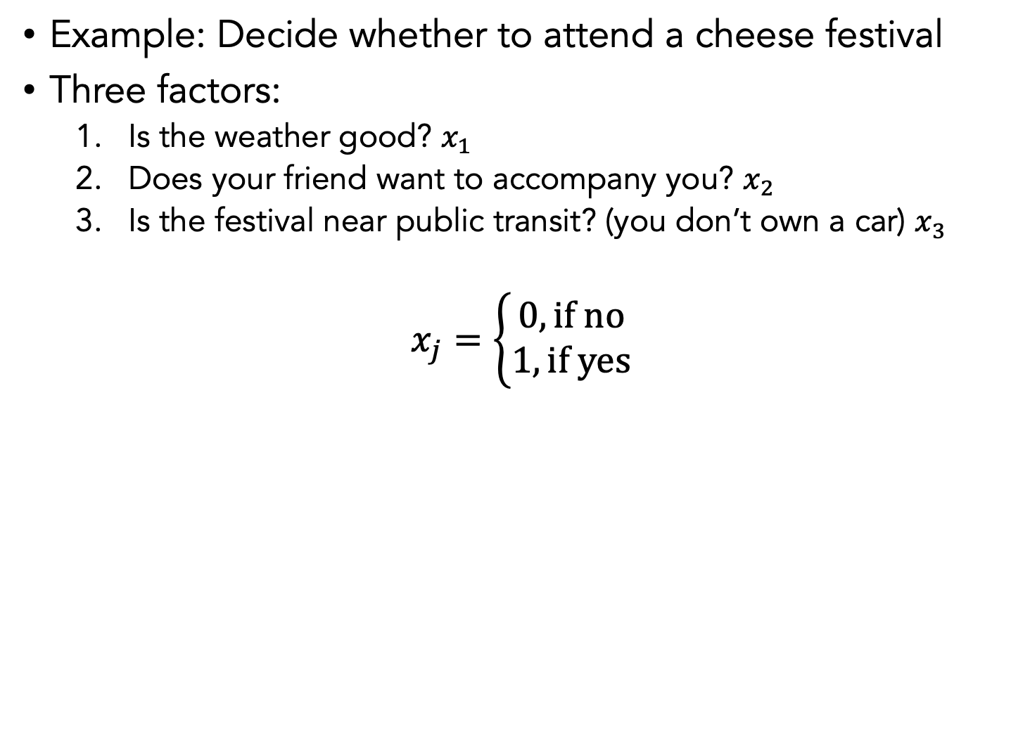
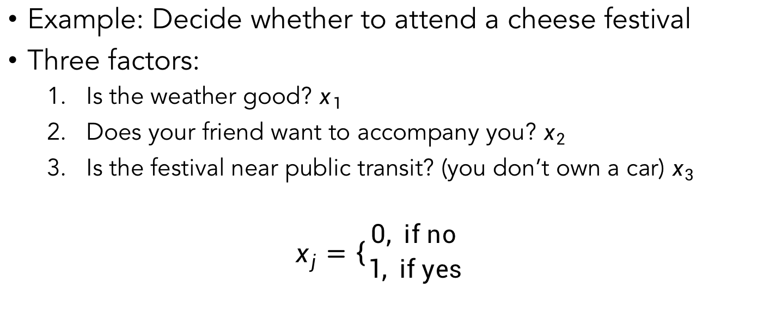
Nielsen, 2015
Example: Decide whether to attend a cheese festival
Three factors:
Is the weather good? $x_{1}$
Does your friend want to accompany you? $x_{2}$
Is the festival near public transit? (you don’t own a car) $x_{3}$
$$x_{j}=\left\{\begin{aligned}0, \text{if} \text{no} \\ 1, \text{if} \text{yes}\end{aligned}\right.$$

Slide 35
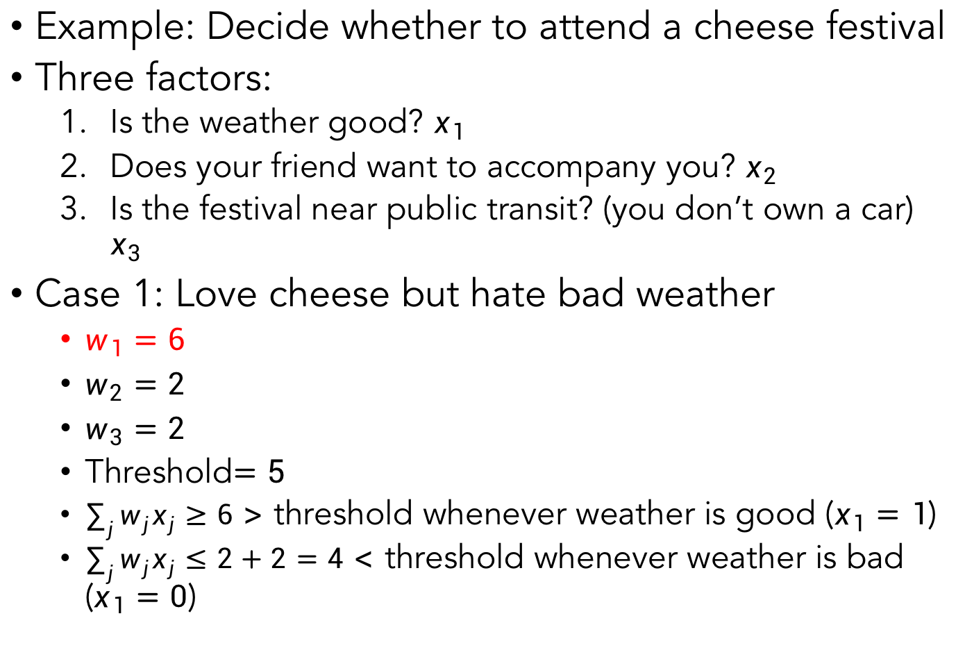
Example: Decide whether to attend a cheese festival
Three factors:
Is the weather good? $x_{1}$
Does your friend want to accompany you? $x_{2}$
Is the festival near public transit? (you don’t own a car) $x_{3}$
Case 1: Love cheese but hate bad weather
$w_{1}=6$
$w_{2}=2$
$w_{3}=2$
Threshold$=5$
$\sum_{j}{w_{j}x_{j}}≥6>$ threshold whenever weather is good ($x_{1}=1$)
$\sum_{j}{w_{j}x_{j}≤2+2=4}<$ threshold whenever weather is bad ($x_{1}=0$)
The large value for w_1 indicates that the weather matters a lot more than whether bf or gf attend or nearness of public transit
Notes:
The large value for w_1 indicates that the weather matters a lot more than whether bf or gf attend or nearness of public transit

Slide 36
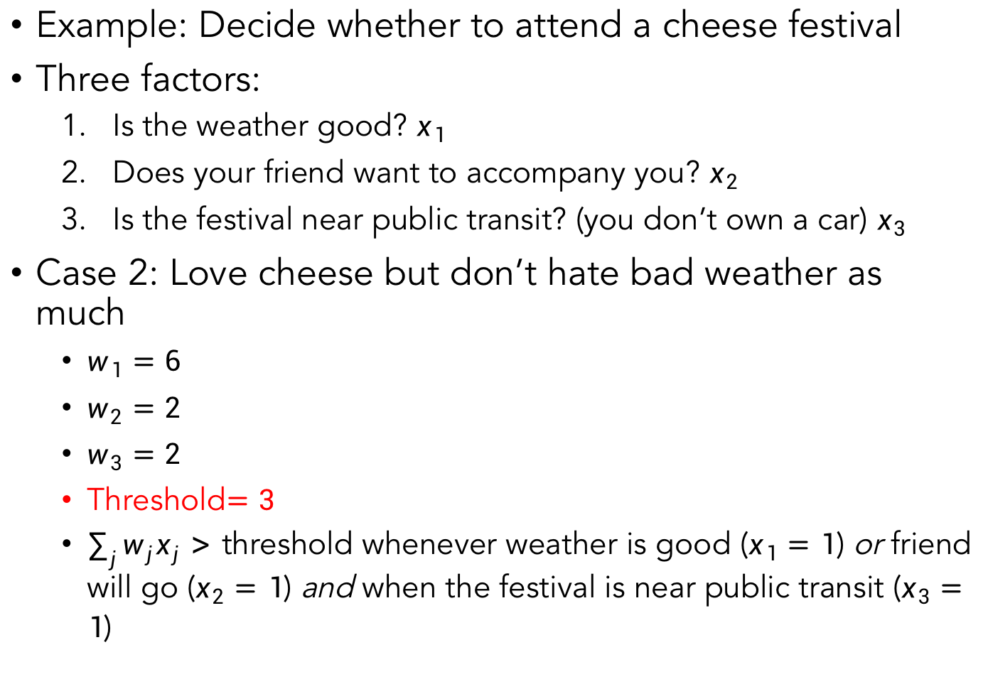
Example: Decide whether to attend a cheese festival
Three factors:
Is the weather good? $x_{1}$
Does your friend want to accompany you? $x_{2}$
Is the festival near public transit? (you don’t own a car) $x_{3}$
Case 2: Love cheese but don’t hate bad weather as much
$w_{1}=6$
$w_{2}=2$
$w_{3}=2$
Threshold$=3$
$\sum_{j}{w_{j}x_{j}}>$ threshold whenever weather is good ($x_{1}=1$) or friend will go ($x_{2}=1$) and when the festival is near public transit ($x_{3}=1$)
Dropping the threshold means you’re more willing to go to the festival
Notes:
Dropping the threshold means you’re more willing to go to the festival

Slide 37
Summary so far
Neural networks are collections of individual neurons or nodes that multiple input values by weights and apply a non-linearity
Layers of nodes allow for increased complexity of calculations (functions of functions)
Neural networks can theoretically approximate any function (given appropriate size)
Creative design of network architecture admits many practical applications across domains

Slide 38
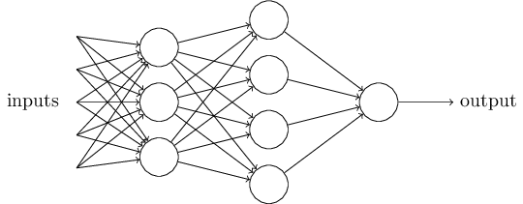
The multilayer perceptron (MLP)
A single perceptron is pretty simple
A complex network of perceptrons can make subtle decisions
In this network, the first column of perceptrons - what we'll call the first layer of perceptrons - is making three very simple decisions, by weighing the input evidence.
What about the perceptrons in the second layer? Each of those perceptrons is making a decision by weighing up the results from the first layer of decision-making. In this way a perceptron in the second layer can make a decision at a more complex and abstract level than perceptrons in the first layer.
And even more complex decisions can be made by the perceptron in the third layer.
In this way, a many-layer network of perceptrons can engage in sophisticated decision making.
Emphasize that it is the same output going to each node
First Layer
Second Layer
Nielsen, 2015
Notes:
In this network, the first column of perceptrons - what we'll call the first layer of perceptrons - is making three very simple decisions, by weighing the input evidence. What about the perceptrons in the second layer? Each of those perceptrons is making a decision by weighing up the results from the first layer of decision-making. In this way a perceptron in the second layer can make a decision at a more complex and more abstract level than perceptrons in the first layer. And even more complex decisions can be made by the perceptron in the third layer. In this way, a many-layer network of perceptrons can engage in sophisticated decision making.
Emphasize that it is the same output going to each node

Slide 39
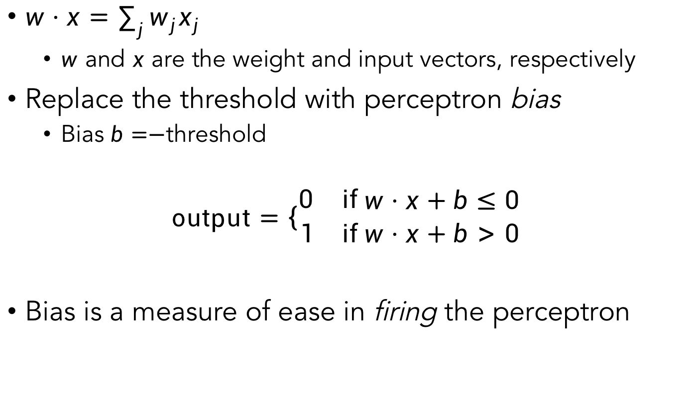
Bias
$w⋅x=\sum_{j}{w_{j}x_{j}}$
$w$ and $x$ are the weight and input vectors, respectively
Replace the threshold with perceptron bias
Bias $b=−$threshold
$$\text{output}=\left\{\begin{aligned}\begin{matrix}0 & \text{if} \end{matrix}w⋅x+b≤0 \\ \begin{matrix}1 & \text{if} w⋅x+b>0\end{matrix}\end{aligned}\right.$$
Bias is a measure of ease in firing the perceptron

Slide 40
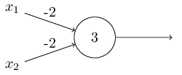
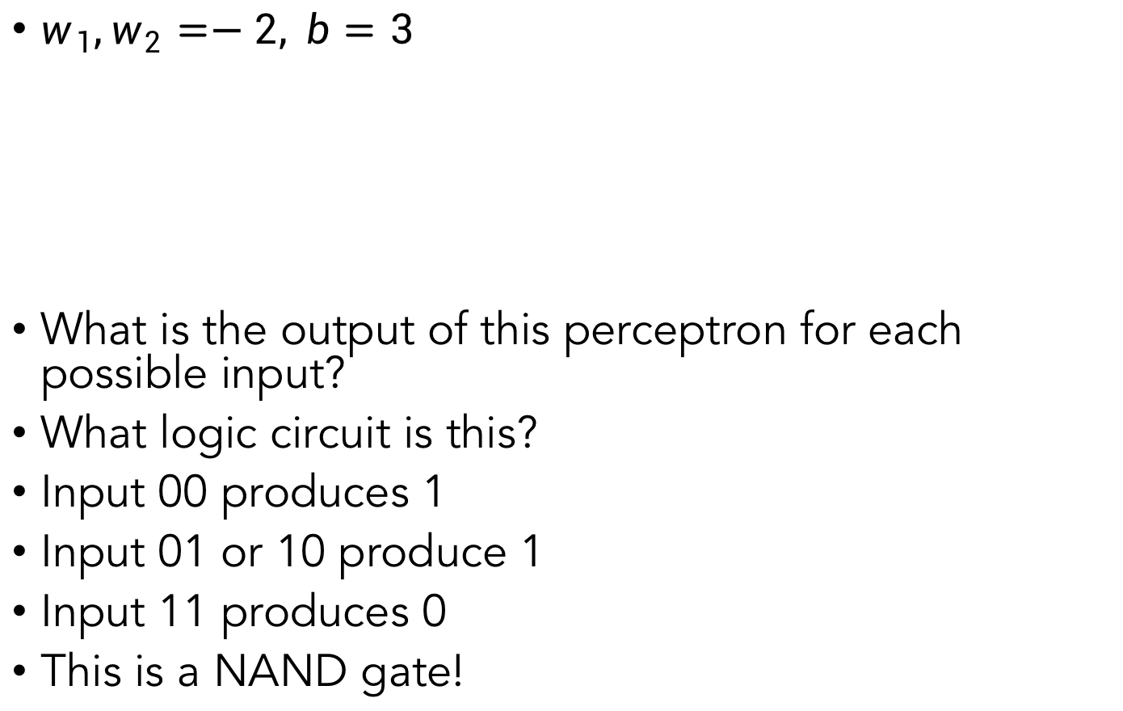
Logic circuits with perceptrons
$w_{1},w_{2}=−2, b=3$
What is the output of this perceptron for each possible input?
What logic circuit is this?
Input 00 produces 1
Input 01 or 10 produce 1
Input 11 produces 0
This is a NAND gate!
Nielsen, 2015
Notes:
Write this on the board maybe

Slide 41
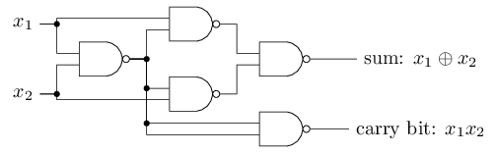
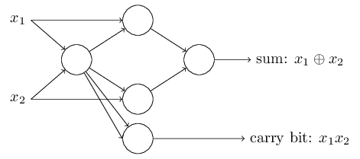
Logic circuits with perceptrons
NAND gates are universal for computation
Any computation can be built from NAND gates
Therefore, perceptrons are universal for computation
Bitwise addition:
Nielsen, 2015

Slide 42
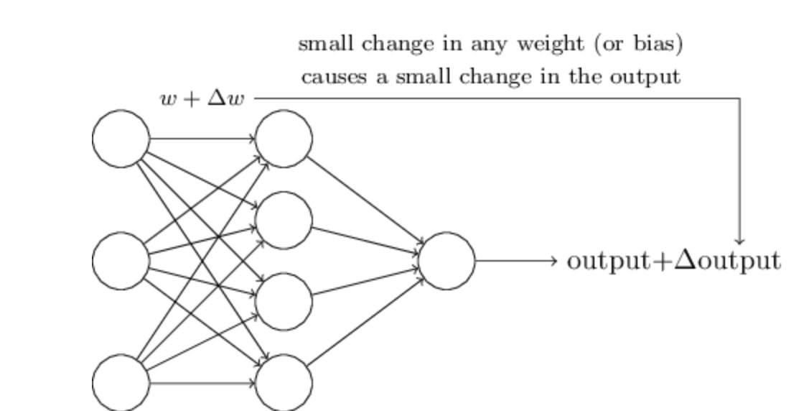
Problem with Logical Functions
Hard to “tune” in a traditional sense
Small change in weight can lead to large changes in conditions (or on change at all)
Think the volume knob in your car behaving this way
For this to happen we need neurons to perform a continuous differentiable function

Slide 43
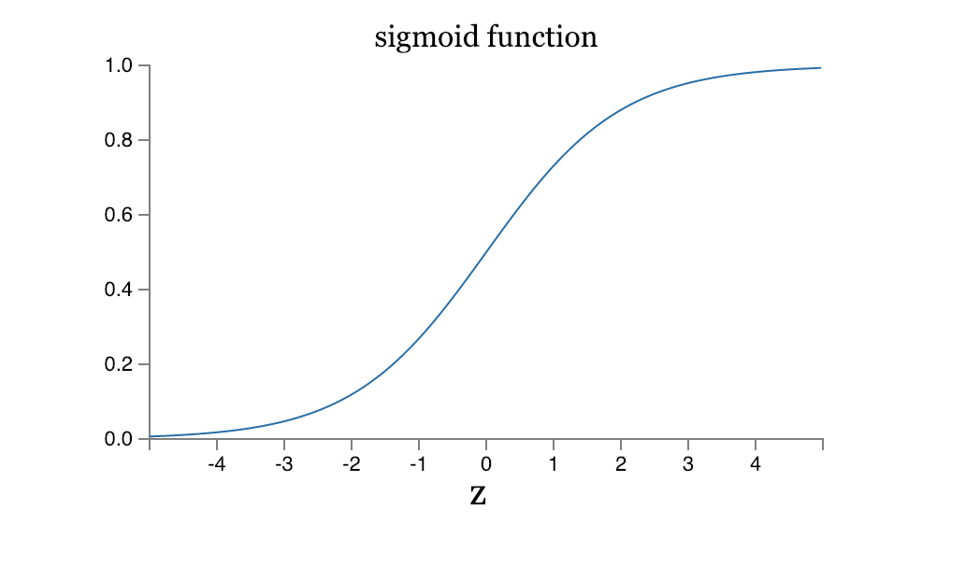
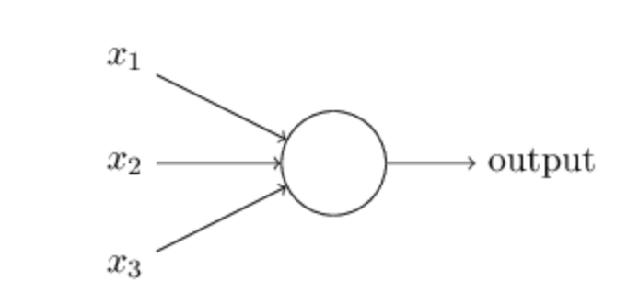
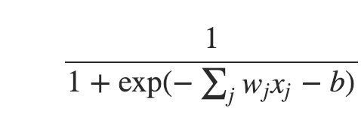
Sigmoidal Neuron

Slide 44

Multi-layers of Neurons

Slide 45

Differentiable Computing
We already know how to make NAND gates, so this is hardly big
We can create learning algorithms that automatically tune the weights and biases with Gradient Descent
Tuning occurs in response to external stimuli and w/o direct intervention
Creates a circuit designed for the problem at hand
Notes:
We already know how to make NAND gates, so this is hardly big

Slide 46
Design choices for an ANN
Activation function (e.g. threshold)
Cost functions
Number and dimension of layers
Connections between layers
Regularizations
Layers
Batches
More…
You can imagine that we can solve a rich set of problems by various design choices.
Emphasize that we can have nonlinear functions and also continuous inputs and outputs instead of binary.
We will cover all of these in detail throughout the course and is a large focus of the beginning
Notes:
You can imagine that we can solve a rich set of problems by various design choices. Emphasize that we can have nonlinear functions and also continuous inputs and outputs instead of binary. We will cover all of these in detail throughout the course and is a large focus of the beginning

Slide 47
Fully connected network
Every feature interacts with every other feature
Weight matrix at every level allowed to be dense

Slide 48
Types of Neural Networks

Slide 49




Convolutional Neural Networks
Very successful in images
Emphasize that CNNs were used for object detection in bottom left
Notes:
Emphasize that CNNs were used for object detection in bottom left

Slide 50

Convolutional Neural Networks
Only pixels that are close to each other in the image interact with each other (convolution layer)
Weight matrices are highly structured
“Pooling” helps to simplify output of convolution layer
Yann LeCun

Slide 51

Convolutional Neural Networks
Weights from the first layer tend to look like directional filters after training
Detects edges, color change, etc.

Slide 52

Convolutional Neural Networks (CNNs)
deep neural networks have led to great success in image classification every year, largely due variations on CNNs
Goodfellow et al., 2016
Notes:
Deep neural networks have led to great success in image classification every year, largely due variations on CNNs

Slide 53

Graph Neural Networks
[Hamilton et. Al]

Slide 54

Recurrent Neural Networks (RNNs)
Useful when time is important

Slide 55
Recurrent Neural Networks (RNNs)
In feedforward nets (everything we’ve considered so far), activations of later layers are completely determined by the input
RNNs allow the hidden layers to be affected by activations at earlier times (i.e. feedback)
E.g. a neuron’s activation may include as input its activation at an earlier time
Cycles are now included in the network
This time-varying behavior make RNNs useful for analyzing data that change over time (e.g. speech)
Training can be difficult for long-term dependencies

Slide 56

Recurrent Neural Network
By Chrislb - created by Chrislb, CC BY-SA 3.0, https://commons.wikimedia.org/w/index.php?curid=224513

Slide 57
Transformers

Slide 58

Autoencoders
Somewhat similar idea to PCA
Attempts to compress the data and then reconstruct the input
“Bottleneck” layer
Reconstruction
By Chervinskii - Own work, CC BY-SA 4.0, https://commons.wikimedia.org/w/index.php?curid=45555552
Notes:
Somewhat similar idea to PCA

Slide 59

Autoencoder Applications
Pretraining
Dimensionality reduction
Information retrieval
Denoising
Data compression
Generative modeling
Batch correction
Goodfellow et al., 2016

Slide 60

Ultra Deep Learning (e.g. ResNet)
Very deep neural nets are difficult to train
Accuracy can degrade with deeper networks
ResNet developed a framework to address this degradation
Successfully trained a 152 layer network
Won the ILSVRC 2015 image classification task
arxiv.org/abs/1512.03385

Slide 61
GANs

Slide 62

Generative Models
Visualization of samples from the model.
The rightmost column shows the nearest training example of the column just to the left.
Notes:
Visualization of samples from the model. The rightmost column shows the nearest training example of the column just to the left.

Slide 63


Deep Reinforcement
Alpha Go Zero
Alpha Zero

Slide 64
Applications

Slide 65

Genomics: Enhancer Binding
(Alipanahi et al. 2015)

Slide 66

Image Colorization
(Zhang et al., 2016)

Slide 67

Style Transfer
(Gatys et al., 2015)

Slide 68
Object Detection
This was one of the breakthroughs, and even better results can be obtained now.
Agaric is a type of mushroom
(Krizhevsky et al., 2012)
Notes:
This was one of the breakthroughs, and even better results can be obtained now. Agaric is a type of mushroom

Slide 69
Text Generation
This was trained on entire works of Shakespeare
(Andrej Karpathy blog, 2015)
Notes:
This was trained on entire works of Shakespeare

Slide 70
Image Captioning
Extension to captioning videos
(Karpathy & Fei-Fei, 2015)
Notes:
Extension to captioning videos

Slide 71
Further reading
Nielsen, Chapter 1
Goodfellow et al., Chapter 1
So if you were confused by some of the terms used like supervised, unsupervised, etc,
this is when we’ll cover it a lot of those basics.
For more background material, look into the Goodfellow book.
Notes:
So if you were confused by some of the terms used like supervised, unsupervised, etc, this is when we’ll cover it a lot of those basics. For more background material, look into the Goodfellow book.

